Slide 1



AUTONOMOUS SHIPPING Sprint 4
Jasper Vlaar, Jelte Molenaar, Job Vink, Michiel van Soest en Martin de Rijke

Slide 2
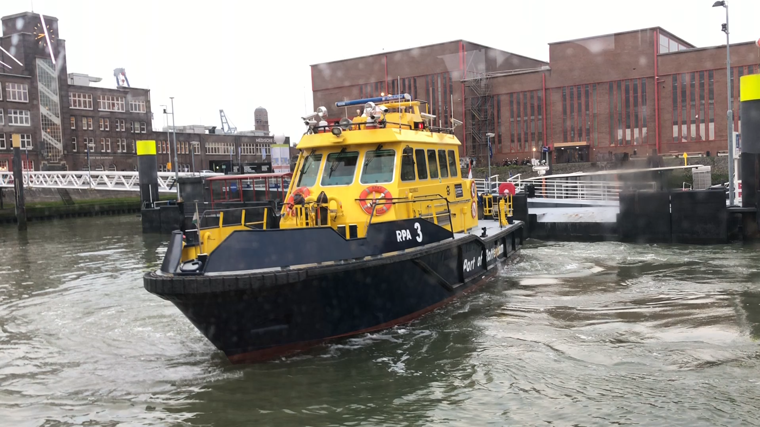
Autonomous shipping

Slide 3
Topics
Improving wall detection
Hyper parametering
Research Paper
Related work

Slide 4
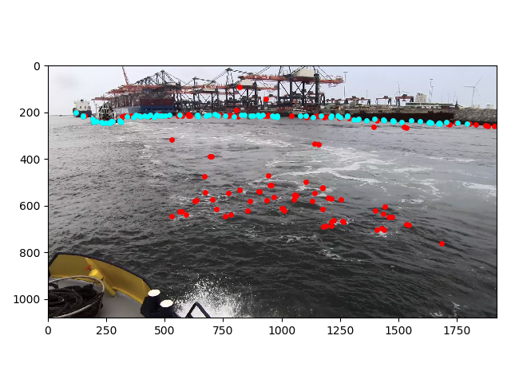
Choosing hyperparameters

Slide 5
Research Paper
Setup: Related work
Verifying current methods
Dividing responsibilities

